Slide 1
Solving Systems of Equations Using Matrices
Dr. Jacob Moore
Associate Professor of Mechanical Engineering
Penn State Mont Alto

Slide 2
Systems of Equations and Matrix Equations
A set of related equations is known as a system of equations.
A linear equation is any equation that consists of simple constants and variables.
An example of a system of linear equations is the set of equilibrium equations from a statics problem or the equations of motion from a dynamics problem.
You will likely have multiple equations that share some variables.
Any system of linear equations can be rewritten as single matrix equation.

Slide 3
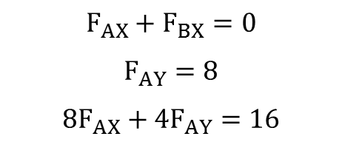
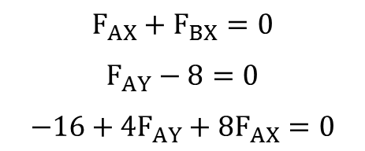
Rewriting a System of Equations as a Matrix Equation
Rearrange the equations so that all constants are on one side while all variables with coefficients are on the other side.
It is also useful to have the variables in the same order in all equations.
$$F_{AX}+F_{BX}=0$$
$$F_{AY}−8=0$$
$$−16+4F_{AY}+8F_{AX}=0$$
$$F_{AX}+F_{BX}=0$$
$$F_{AY}=8$$
$$8F_{AX}+4F_{AY}=16$$

Slide 4




Rewriting a System of Equations as a Matrix Equation
Put all the coefficients into a n x n matrix
Each row represents a single equation.
Each column represents a single variable.
put in zeros where the variable does not exist.
Coefficient or ‘A’ Matrix
$$F_{AX}+F_{BX}=0$$
$$F_{AY}−8=0$$
$$−16+4F_{AY}+8F_{AX}=0$$
$$F_{AX}+F_{BX}=0$$
$$F_{AY}=8$$
$$8F_{AX}+4F_{AY}=16$$
$$F_{AX}$$
$$F_{AY}$$
$$F_{BX}$$
$$\left[\begin{matrix}1 & 0 & 1 \\ 0 & 1 & 0 \\ 8 & 4 & 0\end{matrix}\right]\left[\begin{matrix}F_{AX} \\ F_{AY} \\ F_{BX}\end{matrix}\right]=\left[\begin{matrix}0 \\ 8 \\ 16\end{matrix}\right]$$

Slide 5
Rewriting a System of Equations as a Matrix Equation
Put all the unknowns into a vertical variable matrix.
Make sure the order matches the coefficient matrix
Coefficient or ‘A’ Matrix
Variable or ‘X’ Matrix
$$F_{AX}+F_{BX}=0$$
$$F_{AY}−8=0$$
$$−16+4F_{AY}+8F_{AX}=0$$
$$F_{AX}+F_{BX}=0$$
$$F_{AY}=8$$
$$8F_{AX}+4F_{AY}=16$$
$$F_{AX}$$
$$F_{AY}$$
$$F_{BX}$$
$$\left[\begin{matrix}1 & 0 & 1 \\ 0 & 1 & 0 \\ 8 & 4 & 0\end{matrix}\right]\left[\begin{matrix}F_{AX} \\ F_{AY} \\ F_{BX}\end{matrix}\right]=\left[\begin{matrix}0 \\ 8 \\ 16\end{matrix}\right]$$

Slide 6
Rewriting a System of Equations as a Matrix Equation
Put all the constants on the left side of the equations into a n x 1 matrix
Where n is the number of equations and the number of unknowns (make sure these are equal)
Coefficient or ‘A’ Matrix
Variable or ‘X’ Matrix
Constant or ‘B’ Matrix
$$F_{AX}+F_{BX}=0$$
$$F_{AY}−8=0$$
$$−16+4F_{AY}+8F_{AX}=0$$
$$F_{AX}+F_{BX}=0$$
$$F_{AY}=8$$
$$8F_{AX}+4F_{AY}=16$$
$$F_{AX}$$
$$F_{AY}$$
$$F_{BX}$$
$$\left[\begin{matrix}1 & 0 & 1 \\ 0 & 1 & 0 \\ 8 & 4 & 0\end{matrix}\right]\left[\begin{matrix}F_{AX} \\ F_{AY} \\ F_{BX}\end{matrix}\right]=\left[\begin{matrix}0 \\ 8 \\ 16\end{matrix}\right]$$

Slide 7



Solving a Matrix Equation
To solve for the each of the variables, we would need to “divide” both sides by A.
We do this by multiplying both sides by the inverse of Matrix A.
Doing this by hand for a very large matrix is very difficult and time consuming, but computers can easily find these inverse matrices.
In fact this is how most computer equation solvers work.
$$\left[A\right]\left[X\right]=\left[B\right]$$
$${\left[A\right]}^{−1}\left[A\right]\left[X\right]={\left[A\right]}^{−1}\left[B\right]$$
$$\left[X\right]={\left[A\right]}^{−1}\left[B\right]$$

Slide 8
Why Use Matrix Equations
There are two reasons we may want to use matrix equations and computer programs to solve for the forces in a truss.
Using this method, particularly for large systems of equations may save us time.
If we make a small mistake it is much easier to fix if everything is saved in Matlab code.
Less going back to redo the work.

Slide 9
Solving Matrix Equations in Matlab
We will be using Matlab to solve our matrix equations.
Use the square brackets to denote a matrix []
A comma is used to indicate the next element in the same row.
A semicolon is used to indicate the next row.
The “inv()” function takes the inverse of the matrix
Use the “*” to multiply the matrices
Finally, work in a script file and save your work so you can easily correct any errors.

Slide 10
Thanks for Watching
See other engineering mechanics videos and access the full tool at…

Slide 11
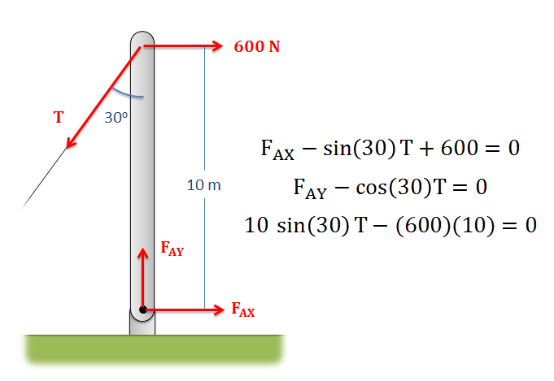
Matrix Equations Worked Example
Turn the system of equations below into a set of matrix equations and then solve the matrix equation in Matlab

